Slide 1
Module 0: Introduction
DevOps Academy
Notes:
Welcome people and say we’re glad to have them,
DevOps is really important
It’s going to be great to spend 2 days going through the course

Slide 2

LOGISTICS
Notes:
Make sure everyone knows to leave in the event of a fire etc.
Check people are comfortable with the building, restrooms etc.

Slide 3
Introduction Video
Notes:
Show the Paul D intro

Slide 4
Personal Introductions
Let’s learn a bit about each other…
Introduce yourself
Name
Office
Reason for attending
Interesting fact about you
Notes:
Try not to take too long over this.
Perhaps the faculty go last as they probably feel like saying more
Keep the flow moving and encourage people to engage.
Consider writing down things people want to learn as a checklist to refer back to.

Slide 5
Roles and Responsibilities
Do this please and we’ll all be happy
FACULTY
Present slides
Help in the labs
Lead discussions
PARTICIPANTS
Ask questions throughout
Contribute your experiences
Constructively challenge
Kindly limit “digital wandering off”
Make notes of things to correct or add for next time
Share on Yammer #DevOpsAcademy
Notes:
3 main points:
1. “Contribute your experiences”
2. Ask if you don’t understand (if you don’t understand something you may not be the only one)
3. Make your own rule about laptops/smartphones – perhaps suggest that people can use them but should try not to get distracted with work back at the office
4. Strongly encourage participation on Yammer – DevOps is about a community of practitioners so enable making new connections with other practitioners

Slide 6
DevOps Academy Training
Why are we here?
TO LEARN:
What is DevOps and why is it relevant
What problem is DevOps trying to solve?
Some very important TECHNICAL concepts related to the DevOps Way of Working
Infrastructure Automation / Infrastructure-as-Code
Continuous Integration & Continuous Delivery
Release orchestration and automation
Computing in the cloud
IaaS, PaaS and SaaS
Monitoring and operation
To get inspired and get involved with the DevOps community!
Notes:
Stress that we are here to learn the things on the slides
The focus is on the technical side of things
We’re going to use Cognitive learning approach – hear, discuss, do (in a lab), discuss

Slide 7
DevOps Academy Training
What are we not going to cover?
Organisational Change Management
Governance or Compliance
How to implement Agile
How to shape organisational culture
How to be a Developer
How to be a Tester
How to be a Systems Administrator
How to be a etc…
However these things are all VERY IMPORTANT to the success of DevOps!
When the power of love overtakes the love of power, that’s when things will really change
Jimi Hendrix
Notes:
These things are out of scope
Culture, organisational models and removing silos are all very important - but not the detailed focus of this course

Slide 8
Learning Objectives
Upon completing this course participants will have:
Understood underlying principles and benefits of Continuous Integration, Continuous Delivery and DevOps
Made use of public cloud infrastructure (AWS)
Assembled a Continuous Delivery pipeline capable of automated deployment of code into a target environment they have created
Stood up a project tooling environment in the cloud that supports our new DevOps Way of Working (aka Accenture DevOps Platform).
Used Distributed Version Control tools to make changes to code
Built a lightweight environment in the cloud using cloud automation techniques (AWS)
Notes:
Get people to read this and ask if they have any other objectives
Encourage people to validate their expectations to make sure they’re getting the intended value out of the course
Key points – understanding the principles and seeing these things first hand (through the use of cloud)

Slide 9
Format Of Training Course
Training Structure
A total of 9 modules (0-8)
Approx 4 modules per day
Module format
Slides > Labs
Discussion > Summary > Questions
DAY 1: TOOLS & CONTINUOUS DELIVERY
Core concepts
Delivering Services in the Cloud
Software Configuration Management
Continuous Integration
Code Quality
DAY 2: ENVIRONMENTS
Infrastructure as Code
Cloud Deployment Patterns – IaaS, PaaS, SaaS
Containers
Resilient Operations
Notes:
Key points:
1st day is CD
2nd day is Infra as Code
Module format
4 or 5 modules per day each with their own labs

Slide 10

MODULE 0 Introduction to DevOps
Notes:
You could treat these dividers as “tweet” breaks, i.e. a chance for people to Yammer
Or ask questions to the class

Slide 11
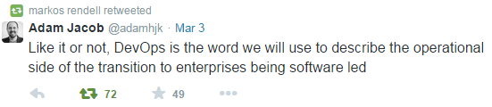
Notes:
Adam Jacob the CIO of Chef (with whom Accenture DevOps are partnered recently)
Said this
Which is basically –if it’s about improvement, you might as well call it Devops
Not bad, but we can do better

Slide 12

DevOps An Accenture definition – Martin Croker and Markos Rendell
The engineering discipline of optimising both Development and Operations to enable the realisation of business goals through rapid feedback, stable, responsive and flexible IT.
Notes:
This is a definition of DevOps as evolved by Martin Croker (global DevOps lead) and Mark Rendell (DevOps Shared Service lead).
It could be translated as:
Someone in the Business has a good idea
We (the IT team / service provider)
will endeavour to take the idea and get it implemented as soon as possible
So that the results of the idea can be demonstrated as quickly as possible
Speed of feedback is our highest priority

Slide 13
What is DevOps?
“We are going to have to work together”
DevOps
I want change
I want stability
Development
Operations
I like
Stable and operable software
Consistent and optimised release process
Adherence to architectural and platform standards
Classic Characterisation: an end to “Dev versus Ops”
I like
Low risk, high throughput of change
Integration confidence and architectural integrity
Highly available and dependable environments
Notes:
Walk through animation
The classic view of DevOps is that enterprises have IT split into 2 silos: Dev and Ops
As per this slide, they have opposing objectives and major obligations to each other
DevOps seeks to blend these two silos into an empathetic, collaborative unit and to balance the objectives and obligations

Slide 14
What does the DevOps challenge really look like?
Usually there are way more than just two teams in the mix
TRADITIONAL
MANY TEAMS…
Traditional operations
Cloud Operations
(or Shadow IT)
Development Team
Operations Team
ERP owner
UI agency
Mobile partners
CMS
Site
IB
CMS
Site
IB
“Legacy System” owner
CRM owner
SaaS Operations
(or self-managing teams)
CMS vendor
Tools
PIM
DB
Tools
PIM
DB
Platform
NO OPS?
DCSC-PREFERRED (Product-oriented teams)
Development and Operations Team
CMS
Site
IB
Development and Operations Team
Development and Operations Team
Development and Operations Team
Development and Operations Team
Development and Operations Team
CMS
IB
Site
PIM
Tools
PIM
DB
Tools
Platform
Platform
DevOps is “…the org structure that lets you release as fast as possible without losing control”
Markos Rendell
http://markosrendell.wordpress.com/2014/09/25/paaa-is-great-for-devops-too-treat-your-platform-as-a-product/
Notes:
Presenter’s note: The introduction mentions that operational models will not be discussed so this slide can make it awkward to then be talking about which org structure to use. Consider skipping it – Rene Medellin
---
The message her is that there are lots of options for implementing organisational structures depending on the client scenario.
The Traditional characterisation of DevOps is that there are 2 silos
2 would be very nice, in Accenture engagements there are usually loads – across different suppliers
You could try one massive team (sometimes called NoOps) – but is this an illusion and really there will still be sub-silos
DCSC prefer to own the “platform” end to end and let other teams own their applications that run on the platform
Mark Rendell came up with this idea of Accenture DevOps teams holding themselves to the standards provided by PaaS providers
The key message is that ideally the “value stream” from idea to a changed component being released should cross as few team barriers as possible. Organising end-to-end by components is a way to do this.
So good services (e.g. IaaS) are not the same as bad silos.
Warn people:
Mustn’t create another silo
All teams can aspire to becoming Continuous Delivery and DevOps capable
However, still need accountability for high performance of these functions

Slide 15
What do we need to get right?
Balancing these priorities typically requires excellent:
Software and Infrastructure Automation
Environment Management
Application Lifecycle Management
Configuration Management
Tooling
Collaboration
Notes:
Talk through briefly how all of these things are important.
Software and Infrastructure Automation: we are going to move to quickly to do things by hand in a risky manual way
Environment Management: Environments should be predictable, available and not get in the way
Application Lifecycle Management: We need to plan well and ensure traceability
Configuration Management: We need to control all of the moving parts
Tooling: We need technology
Collaboration: We can’t do this in isolated pockets, the scope is too wide.

Slide 16
DevOps In The Market
Agile 2008 Toronto Andrew Clay Shafer proposes ‘birds-of-a-feather’ adhoc talk on ‘Agile Infrastructure’. Only 1 person attends – not Andrew. He skips his own session! Patrick Debois was the person who turned up
Emergence of DevOps (some highlights)
Taiichi Ohno and Eiji Toyoda develop the Toyota Production System (TPS) a precursor to Lean Manufacturing
‘Continuous Integration’ emerges as a practice in teams. CruiseControl open source in 2001. CI a core practice in Extreme Programming (Kent Beck). Fowler further develops
Gathering of early adopters of “light” development methodologies in Snowbird ski resort, Utah, gives rise to The Agile Manifesto: “Our highest priority is to satisfy the customer through early and continuous delivery of valuable software”
1984 The Goal was published by Eliyahu Goldratt
1948-1975
1984
2000
2001
2008
2009
John Allspaw and Paul Hammond present at Velocity 2009: 10 Deploys Per Day at Flickr
http://www.slideshare.net/jallspaw/10-deploys-per-day-dev-and-ops-cooperation-at-flickr
First DevOpsDays conference in Ghent, Belgium in October 2009 organised by Patrick Debois (first use of the DevOps portmanteau). Patrick liked acronym DoD (Dead on Delivery)
Partly to save 4 characters from the #DevOpsDays hashtag, DevOps became the name.
Notes:
Gauge the audience in terms of how much of the history they are interested in
If nothing else, mention the points in bold (green coloured)
The TPS is the key to all these practices. Cosider 2000-2001 the “Age of Thoughtworks” that led to the Agile movement. Starting in 2009 Age of Velocity Ops begins as high-performing IT starts becoming heavily influenced by Silicon Valley “unicorns” – Rene Medellin

Slide 17
Second annual DevOps Enterprise Summit held in San Francisco bringing together representatives from large and complex orgs across many verticals including government, financial services, retail, media, etc… DevOps is mainstream!
http://devopsenterprise.io/
Things have been moving fast…
July 2010 Continuous Delivery book comes out
November 2010 first edition of DevOps newsletter: http://www.devopsweekly.com/
January 2013 the Phoenix Project – the first DevOps novel
October 2013 Allan Kelly blogs #NoProjects
2010
2011
2013
2014
2015
Cameron Haight from Gartner predicts DevOps would be mainstream by 2015
2011 Large software vendors start using the word DevOps extensively and start developing DevOps offerings
March 2014 QCon London – Etsy announce they are doing 50 deploys/day
Amazon announce they are doing at peak 1079 deploys/hour i.e. 1/11.6 seconds
http://itrevolution.com/the-history-of-devops/
Notes:
Gauge the audience in terms of how much of the history they are interested in.
If nothing else, mention the points in bold (green coloured)

Slide 18
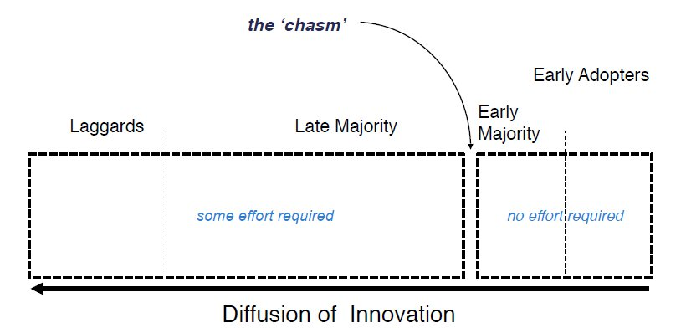
DevOps In The Market
Diffusion of Innovation Theory (from right-to-left)
https://en.wikipedia.org/wiki/Diffusion_of_innovations
Notes:
Presenter’s note: If familiar with the theory of Diffusion of Innovation, unhide and use this slide – Rene Medellin
---
Before considering “where DevOps is?” or “where is X in relation to DevOps” it’s important to understand a bit on how Innovation travels through a social environment. This is one useful theory – Rene Medellin

Slide 19
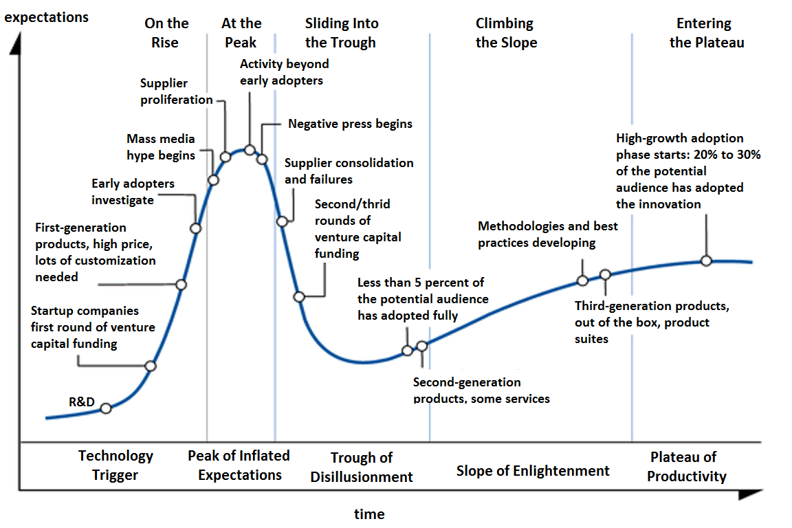
DevOps In The Market
Gartner Hype Cycle… where is DevOps?
Late Majority
Early Majority
Notes:
Explain that this is Gartner’s way of tracking the hype cycle for new trends – emphasis on “trend” not on maturity or achievement
Where is DevOps?
Where DevOps is depends on the population of practitioners you happen to be looking at as per the Diffusion of Innovation theory – Rene Medellin

Slide 20
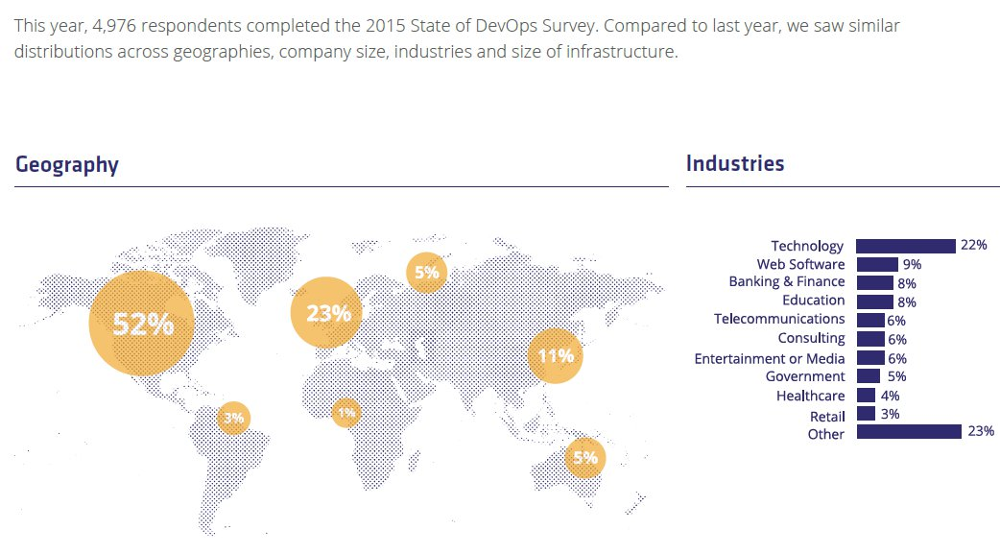
DevOps In The Market
Market adoption of DevOps
http://puppetlabs.com/sites/default/files/2015-state-of-devops-report.pdf
Notes:
This is really just highlighting how ubiquitous the DevOps Way of Working has become

Slide 21
DevOps In Accenture
Adoption of DevOps-like practices in Accenture projects
Evolution of DevArch
Around 1991 the term Development Architecture was first included in Accenture methodologies
Nightly builds and automated deployments of Client Server applications on AIX at North West Water
Accenture had very industrialised ways of delivering COBOL Applications. Deign/1 and Install/1 provided complete UI, navigation and data access module code generation for IBM 3270/CICS/DB2 environments.
1991
1995
2001
2003
2004
“proto-Moose” developed for Customer/1 - using PVCS and make - multiple, intraday application releases to multiple, virtual system test environments.
use of VMWare to provide virtual environments on Jupiter.
the first version of the Moose Build and Deployment tool was written
the second version of Moose was created for the Centrica Jupiter project
Notes:
Don’t try to read the whole time line. Pick one or two favourites to call out.
Dev Arch is older than Accenture (goes back into the Anderson Consultancy days)
We’ve been doing automation in a DevOps-like fashion since at least the 1990’s

Slide 22
DevOps In Accenture
Adoption of DevOps-like practices in Accenture projects
Accenture invested in creating Moose 4
Accenture entered commercial agreement with Rational to bring ClearCase and ClearQuest to all projects (at that time the best options for Version Control and ALM)
2005
2006
2007
2012
2016
the third version of Moose was created for the DWP project
the Development Control Services Centre (DCSC) was created – providing shared DevOps services
“Monsoon” is named
DCSC now has 230 people globally and supports over 300 clients
first DevArch Principles Workshop and DCS Bootcamp training courses
Accenture Open Sourced their DevOps Platform
Notes:
Mention: Accenture Open Sourced their DevOps Platform

Slide 23
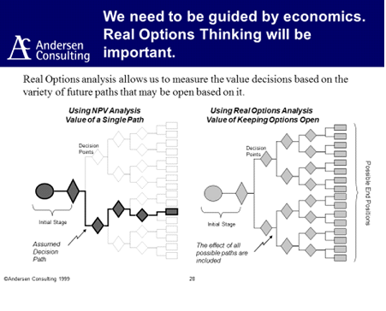
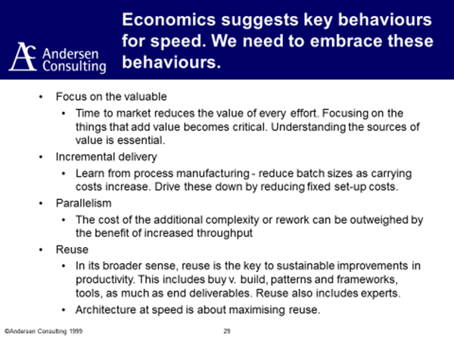
Anderson Consulting’s “DevOps” in hindsight
Notes:
Pick out anything that interests you on this slide or just say: “interesting to see similar ideas emerging as far back as 1999”

Slide 24
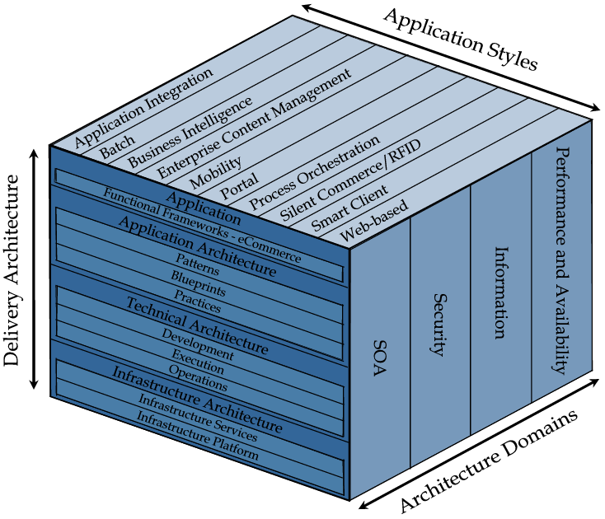
Technical Architecture
Development Architecture
Technical Architecture defines the technical services and system software required to support one or more application styles. It is decomposed into the following architectural environments:
Development Architecture
Supports the development of applications (and the other elements of the technical architecture). It consists of technology services, tools, techniques, and standards for designing, building, and testing new application software and technical architecture components.
Execution Architecture
Supports applications at run-time. It is a unified collection of run-time technology services, control structures, and supporting infrastructure upon which application software runs.
Operations Architecture
Supports the ongoing support and maintenance of applications (and the other elements of the technical architecture). It consists of a unified collection of technology services, tools, standards, and control structures required to keep a business application production or development environment operating at the designed service level.
Notes:
Ask who is a TA or knows this stuff
Mention the TA programme is a GREAT thing to be involved in: https://go.accenture.com/mta
Get them to tell their version of what this is
If nothing else, highlight the Dev Arch definition

Slide 25
Example DevArch materials from ~2006
External from Build
How do developers work efficiently? IDEs? Compilation?
Packaged products?
Code generation?
How do testers work efficiently Isolation? Automation?
Environment Configuration
Configurable Items
Development Environment
Build
Deployment
Test Environment
Applicable to Test & Production
Configuration Management
Notes:
Highlight that the principles haven’t changed
DCS drew this circa 2006
The CD book defined pipelines in 2010

Slide 26

WHAT DOES THIS MEAN FOR PEOPLE?
Notes:
Every section we’re going to reflect on what it means for people in Accenture and our clients?
Ask the class what the last section could mean to people in Accenture and our clients?
Some suggestions:
DevOps skills are in great demand and we need to grow our capability and build up the internal community of practitioners
Ops Arch, Tech Arch and Dev Arch now closer

Slide 27
MODULE 0 Key DevOps Concepts

Slide 28
IDEA
PLAN
DESIGN
BUILD
DEPLOY
TEST
RELEASE
OPERATE
Execution Architecture
Development Architecture
Testing Strategy
Ops Arch
Design Thinking
Systems Thinking
Agile Development
Continuous Integration
Continuous Delivery
DevOps
Lean Startup
Lean Enterprise
Notes:
The idea here is all these methodologies have evolved to optimise the basic software delivery lifecycle in different ways,
Bringing more and more focus on collaboration
And hence more and more value creation
To logical destination for all these practices becomes applying Lean techniques in an end to end way between business and customer – Lean Startup
Agile Development goes some of the way to help dev work with the business but traditionally does not reach into Operations
We’ll cover CI and CD in detail later, but fundamentally
CI introduces quality feedback
CD takes you as far as being able to deploy to production at any time
DevOps includes optimising both the building and the running of systems
But the widest view of all is:
Lean and Lean Startup

Slide 29
Alignment with V-Model
DEVELOPMENT ARCHITECTURE
Transition to Production support
Define Blueprint & Strategy
Implement, manage, maintain and improve processes
CONFIGURATION MANAGEMENT
Strategy selection
Management, implementation and maintenance
Select, Design & Build
ENVIRONMENT MANAGEMENT
Design & build
Environment management, maintenance, support
DELIVERY MANAGEMENT
Release Management
Notes:
Get someone to explain the V Model
Stress that despite the waterfall connotations, it is still a good view for working out the key stages to develop and test code
The overlay just means: we care about all aspects

Slide 30
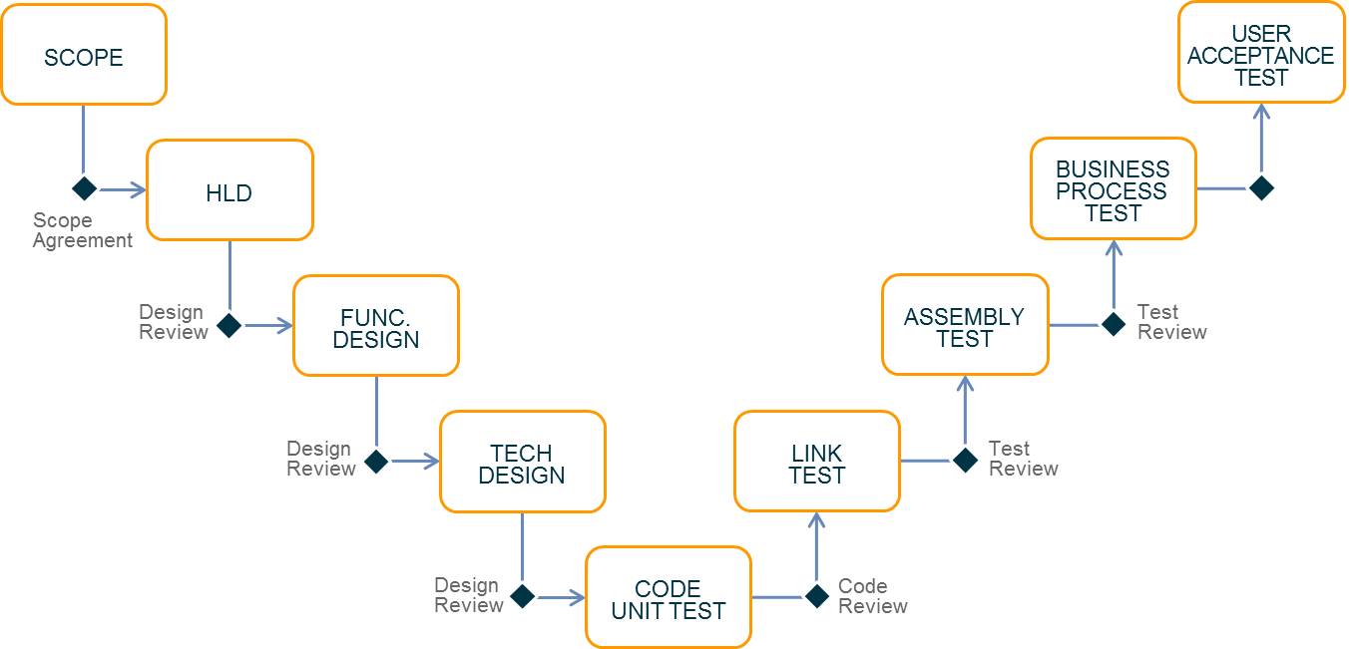
Alignment with V-Model
CODE UNIT TEST
Compile & Package
Committer: jdoe Story:25
Run Unit Tests
Commit ID: 113
Static Code Analysis
Notes:
Where does CI fit in with the V-Model?
Continuous integration is a mechanism for introducing a high amount of feedback during the Development phase
Walk through the steps
Say this is more or less a view from the Jenkins CI tool which we’ll see later

Slide 31
Continuous Delivery
USER ACCEPTANCE TEST
BUSINESS PROCESS TEST
ASSEMBLY TEST
LINK TEST
CODE UNIT TEST
Compile & Package
Run Functional Tests
Committer: jdoe Story:25
Commit ID: 113
Run Unit Tests
Create ST env
Deploy Code
Load Test Data
Run System Tests
Create clustered env
Deploy Code
Run Perf Test
Sonar Code Analysis
Run Integration Tests
Tear down ST env
Run Security Test
Prod deploy
Run Ops Test
Notes:
Where does CD apply in the lifecycle
C Deliv is an automation and orchestration of all steps up right hand side
And the implied steps (deployments) – including (optionally) the last to prod
Ask: who can differentiate Continuous Delivery with Continuous Deployment
Answer Continuous Deployments implies unimpeded delivery directly to prod – no manual gates e.g. manual test phase, manual approval, change advisory board etc.

Slide 32
WHAT DOES THIS MEAN FOR PEOPLE?
Notes:
(Every section we’re going to reflect on what it means for people in Accenture and our clients?)
(Ask the class what the last section could mean to people in Accenture and our clients?)
Some suggestions:
Projects need automation more than ever and most early adopters built their own tooling along the way
Who might build this tooling for Accenture projects to use at scale? – A dedicated team? Every project team along the way?
DCSC model of acting as a provider of “CD PaaS” is good

Slide 33

CLOUD

Slide 34
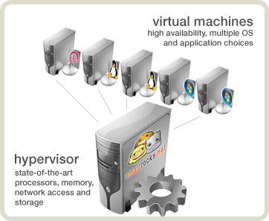
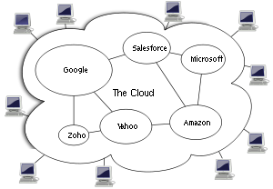
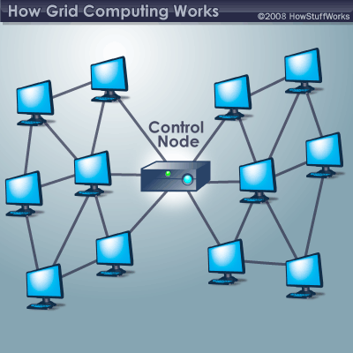
Cloud Basics
What is Cloud Computing?
Collection of computing services (compute, storage, network, etc.)
Accessible on-demand over a network.
Business and technology model for delivering and acquiring IT services in a utility-like fashion.
Virtualization
One computer acting like many
Cloud Computing
A combination of both Virtualization and Grid, but the end user does not have to care about the underlying architecture.
Grid Computing
Many computers acting like one
Utility Computing It is a model in which a service provider makes resources and infrastructure management available as needed, and charges them for specific usage rather than a flat rate.
Notes:
Prompt discussion
Show green box answer
After the first “reveal” ask for 4 main concepts
Cloud Computing is a collection of computing services (compute, storage, network, etc.) accessible on-demand over a network. It is a business and technology model for delivering and acquiring IT services in a utility-like fashion.
Cloud Computing addresses many of the limitations of traditional, on premise IT infrastructure. Cloud computing provides customers with access to remote computing resources, delivered as a service, over the internet. With cloud computing, customers no longer have to purchase and maintain the hardware required to roll out new business applications. Instead, cloud computing allows developers to access computing resources remotely, at any time, through a web browser or through APIs.
Utility computing is a service provisioning model in which a service provider makes computing resources and infrastructure management available to the customer as needed, and charges them for specific usage rather than a flat rate.

Slide 35
Cloud Deployment Patterns
Who manages the layers?
Cloud services provide numerous patterns for providing commodity infrastructure to an IT organization. The overhead in managing some of the underlying technology is transferred to the cloud provider
On Premises comparison
Infrastructure
as a Service
Platform
as a Service
Software
as a Service
Application
Application
Application
Application
Application Architecture
Application Architecture
Application Architecture
Application Architecture
System Software
System Software
System Software
System Software
Database
Database
Database
Database
Operating System
Operating System
Operating System
Operating System
Virtualization
Virtualization
Virtualization
Virtualization
Servers
Servers
Servers
Servers
Storage
Storage
Storage
Storage
Network
Network
Network
Network
Consumer Managed
Provider Managed
Notes:
By stack, get people to state what is included (don’t work too hard on the first one)
Then get people to say who manages what

Slide 36
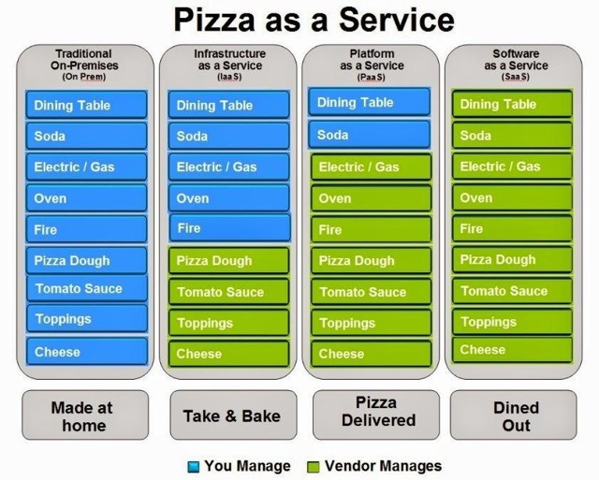
Pizza Illustration
Pizza as a Service
https://www.linkedin.com/pulse/20140730172610-9679881-pizza-as-a-service
Notes:
This helps illustrate the concept

Slide 37
WHAT DOES THIS MEAN FOR PEOPLE?
Notes:
Some suggestions:
What does cloud mean?
Infra is code
We can be much more agile
What do IO do?

Slide 38
Format Of Training Course (reminder)
Training Structure
A total of 9 modules (0-8)
4 modules per day
Module format
Slides > Labs
Discussion > Summary > Questions
DAY 1: TOOLS & CONTINUOUS DELIVERY
Core concepts
Delivering Services in the Cloud
Software Configuration Management
Continuous Integration
Code Quality
DAY 2: ENVIRONMENTS
Infrastructure as Code
Cloud Deployment Patterns – IaaS, PaaS, SaaS
Containers
Resilient Operations
Notes:
Quick reminder

Slide 39

QUESTIONS

Slide 40
LET’S TALK ABOUT THE LAB

Slide 41
Introduction to Lab
What we’re hoping to show you
Using the Cloud is very powerful
Getting started working with the Cloud is quite easy
Getting started working with core DevOps tools is quite easy
How to use CloudFormation
Notes:
This is the important link from the slides to the lab.
Refer back to the things you spoke about and try to draw as many links to what they are going to do as possible.

Slide 42


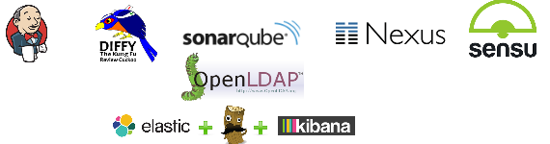
Tooling stack that we will build
Logical view
USERS
PUBLIC IP
VPC
Availability Zone
PROXY
Reverse proxy – provides access to the application and tooling tiers
BASIC TEST ENVIRONMMENT
TOOLS
Tomcat Instance (application)
subnet
Latest https://alm.accenture.com/wiki/display/DOT/Architecture
Notes:
Using CloudFormation template we will create environments and infrastructure required for this training.
This diagram shows a typical secure setup, where the internet facing side is separated from the tooling and applications.
We have three main parts:
The Internet facing section, usually running a reverse proxy or loadbalancer.
The Tooling section, running things like Jenkins, Chef etc
The Applications section, running the deployed applications.
Diagram can become out of date, because of new additions. Latest is always here:
https://alm.accenture.com/wiki/display/DOT/Architecture

Slide 43
Lab – Building the Day 1 tooling stack
Jumpstarting things in the cloud
Go here! Module 1: Standing Up Tools
Duration: ~30 minutes
Notes:
Accessing your AWS account and familiarising yourself with the interface
Creating a CloudFormation Stack from a sample template
Observing and tracking details about Running Servers
30 minutes

Slide 44
DO THE LAB!

